Slide 1
Exploring the determinants of distinct car crash types:
Analyzing factors influencing their occurrence and
identification of key elements for mitigating the risk of car crashes.
Team 4: Jiahao (Michael) Zhang, Zhiyu (Eric) Chen, Avi Dhruva, Jonathan Ham, Brandon Herold

Slide 2
The Problem and Data Source
Problem: What factors contribute to the occurrence of specific car crash types, and which of them we should pay extra attention to in order to avoid a car crash as much as possible.
Dataset: Car Crash Reporting in Montgomery County of Maryland--Driver Data (DATA.GOV)
Outcome Variable: ACRS Report Type (aka. Car Damage Type)
Possible Predictors: Crash Date/Time, Collision Type, Weather, Surface Condition, Light, Traffic Control, Driver At Fault, Circumstance, Driver Distracted By, Vehicle Damage Extent, Vehicle First Impact Location, Vehicle Second Impact Location, Vehicle Body Type, Vehicle Movement, Speed Limit, Vehicle Year, Vehicle Make, Equipment Problems

Slide 3
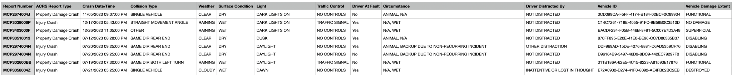
Dataset Summary
Raw dataset
Rows: 172105
Columns: 43
Data Types: integers, strings, floats, booleans
Cleaned dataset
Rows: 16569
Columns: 23
Data Types: integers, strings, booleans
Training / Testing: 80 / 20

Slide 4
Data Cleaning Methodology
We dropped the columns and rows based on following scenarios:
Variables that we think are not helping in analyzing and solving the problem
Too many missing values in that column (over 50% of total observations)
Rows with any missing value included
Rows with “N/A” or “Unknown” values included

Slide 5
Data Cleaning Examples
Column Name | Function | Data Type | Cleaning Decisions
ACRS Report Type | Output variable | String | Change to binary data type [0,1]
Light | Predictor | String | Change to dummy variables
Report Number | Predictor | String | Change to index
Surface Condition | Predictor | String | Change to dummy variables
Drive Fault | Predictor | Boolean | Change to binary data type [0, 1]
Vehicle Make | Predictor | String | Group brands to dummy variables

Slide 6
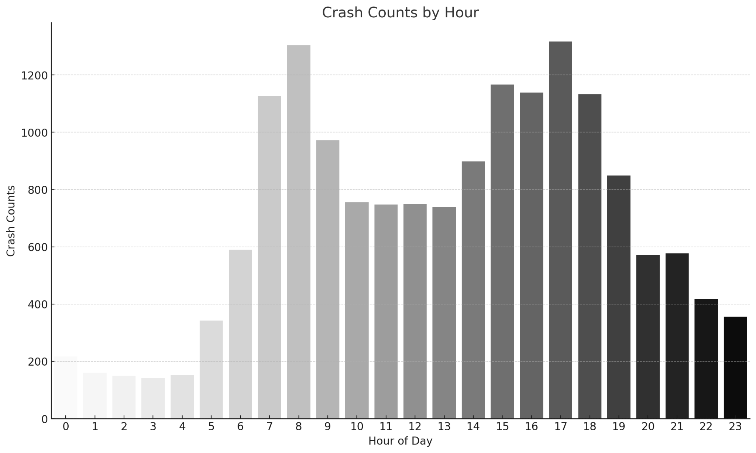
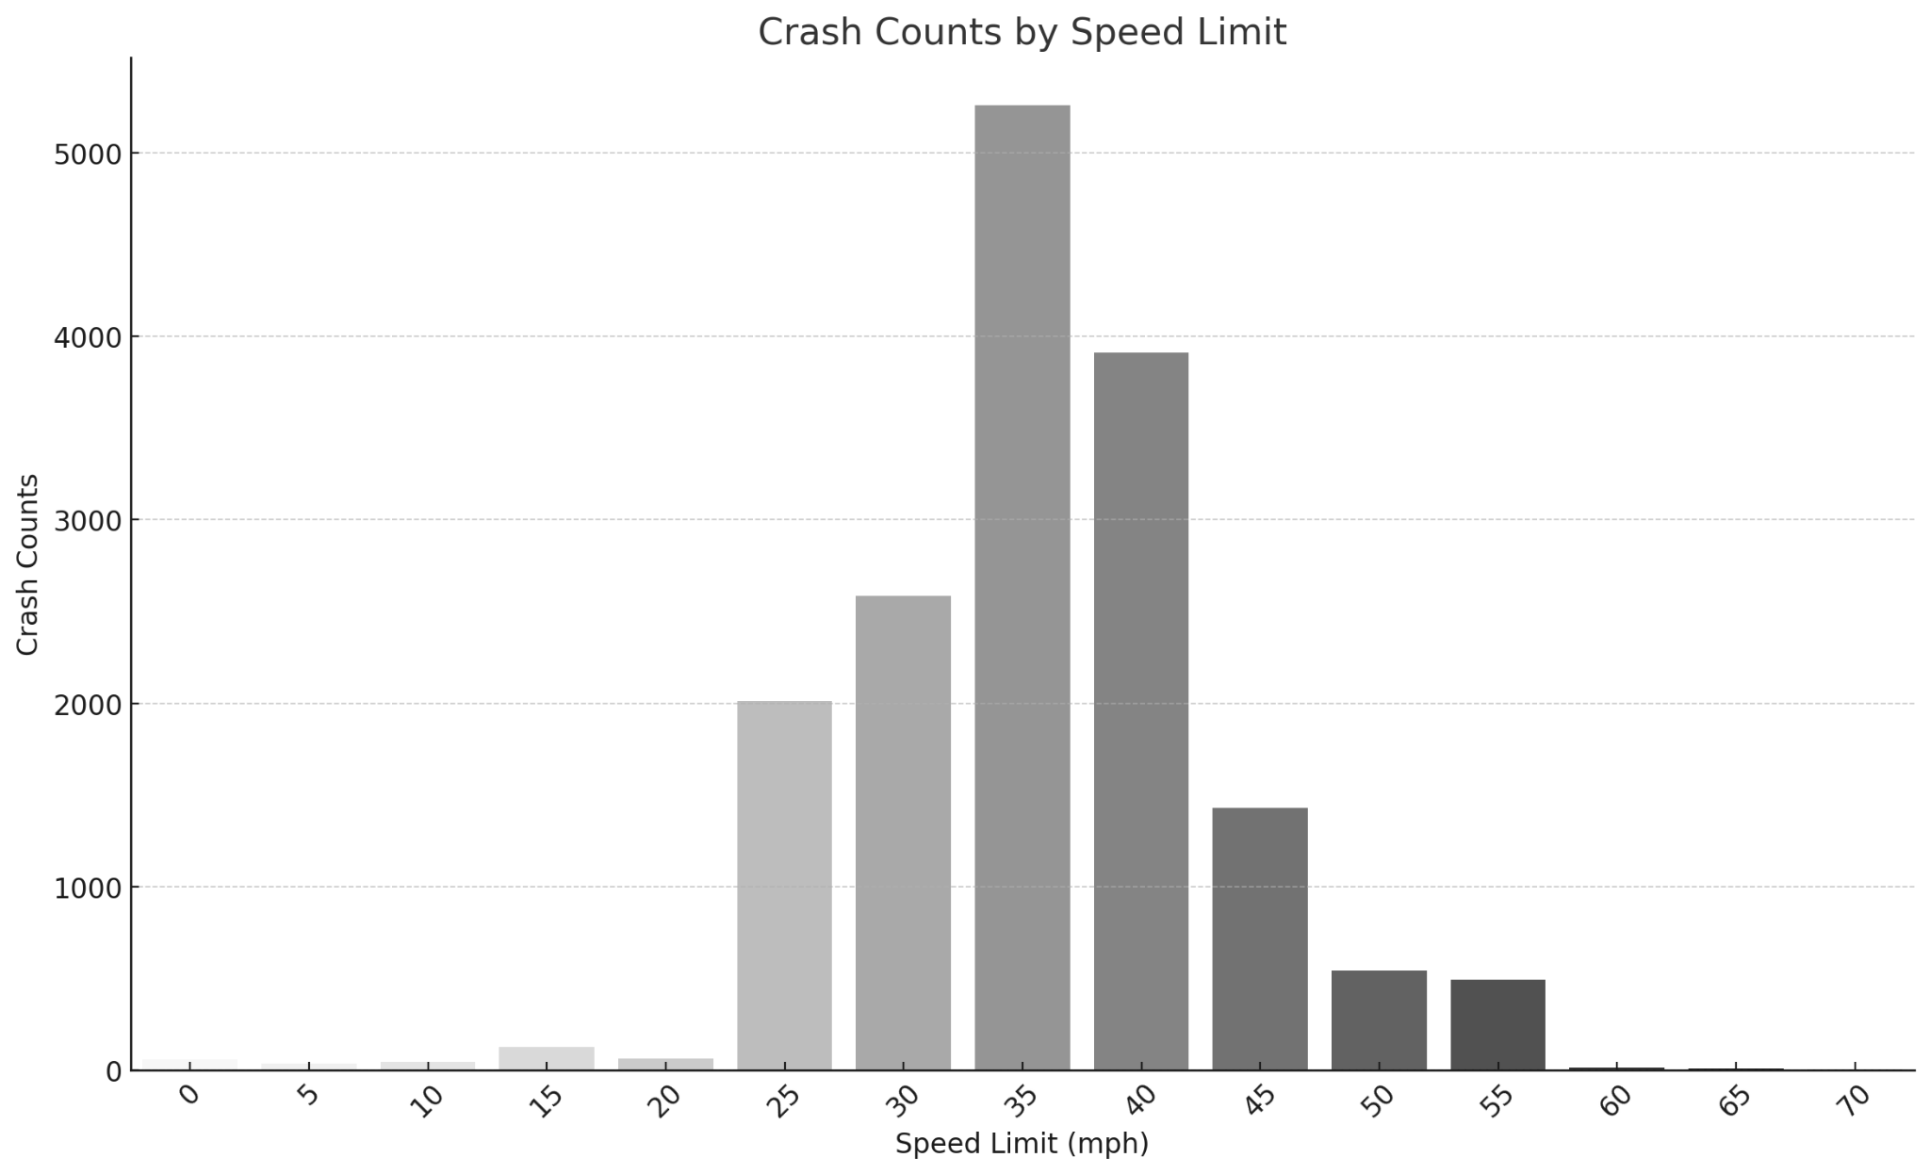
Interesting Findings using Python and Matplotlib
Here we can see that most crashes happen at 8 am and 12 pm which is a common time for morning commutes.
This could explain an increase in crash counts due to higher traffic volume as people travel to work or school.
And here we can see that the most crashes occurred at 35 mph speed limit on average.

Slide 7
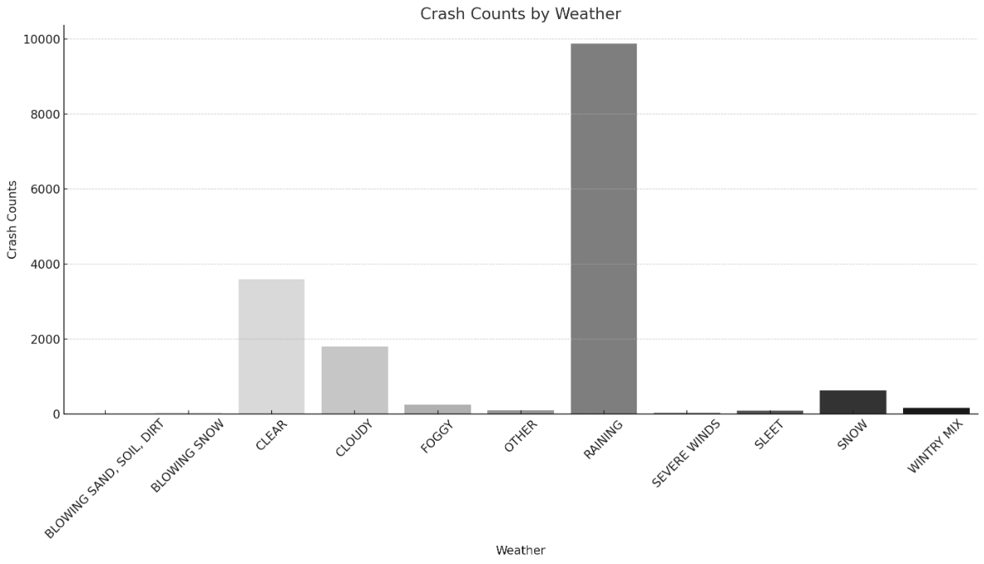
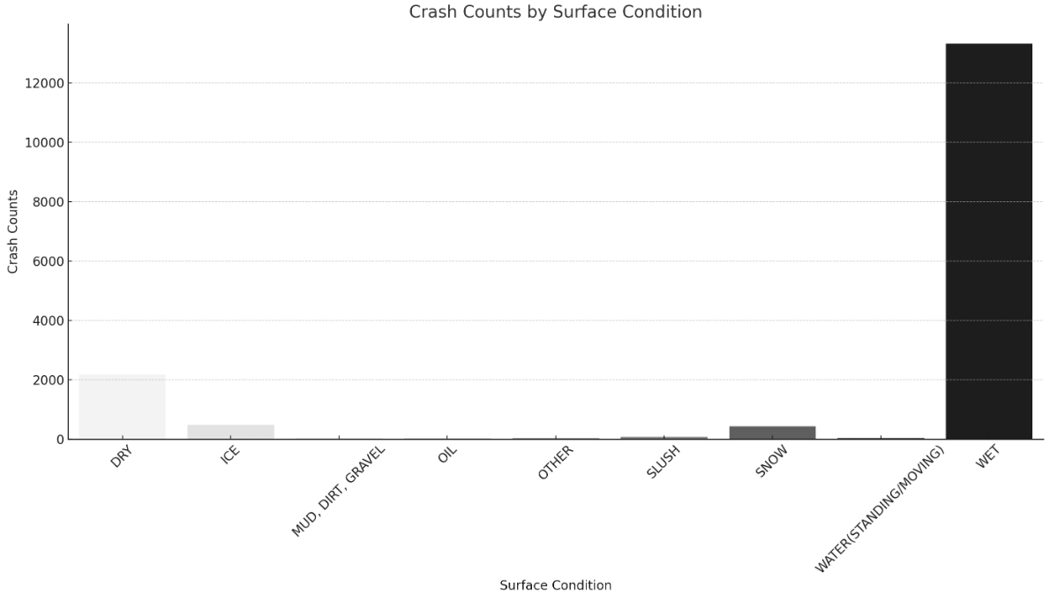
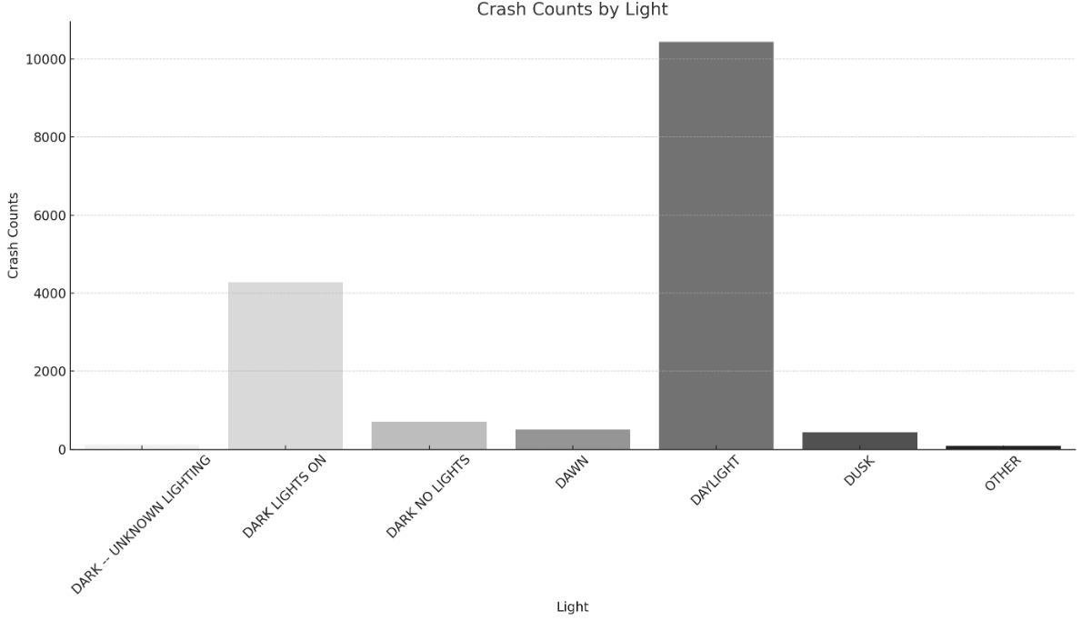
In terms of environmental factors, crashes occurred most often while it was raining, on wet surfaces, and during daylight.
The data we found contradicts our initial assumption that there would be more crashes during the night when visibility is low. However, there is a substantial gap in the number of crashes during daylight as opposed to it being dark.

